Slide 1

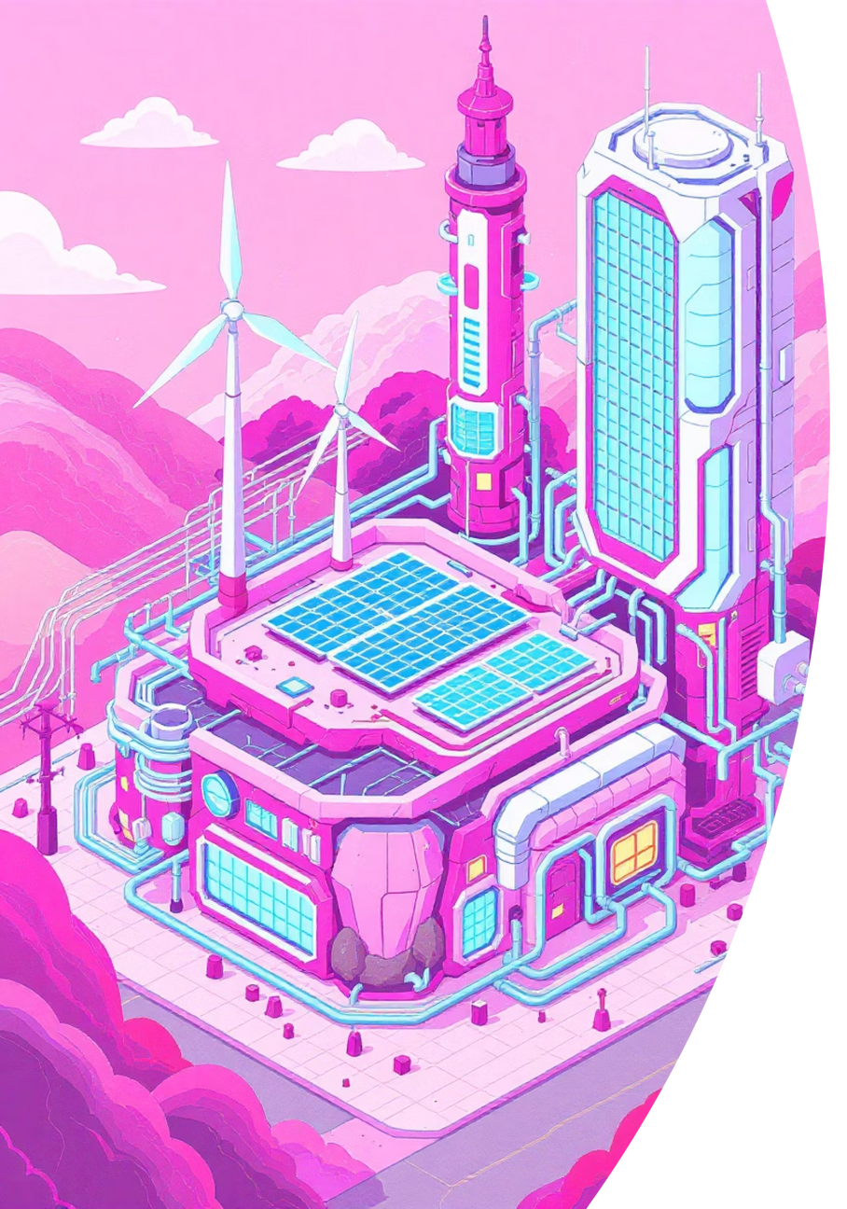
Reinforcement Learning for Smart Microgrids
Optimizing Energy Management for a Sustainable Future
Course- Mini Project
Abhay Raj Yadav(1AT23CG004)
Arpit Singh(1AT23CG019)
Ayush Singh(1AT23CG030)
Notes:
1

Slide 2
Agenda
Empowering Sustainable Energy Systems
01
02
03
The Challenge: Microgrid Complexity
RL Fundamentals for Energy
Building Your RL Microgrid
04
05
Key Decision Variables & Objectives
Expected Outcomes & Impact
Notes:
2

Slide 3

Beyond the Simulation: Real-World Impact
Your work contributes directly to global sustainability goals. This innovative RL approach is a cutting-edge method for energy management, applicable far beyond your simulation.
SDG 7: Affordable and Clean Energy - By optimizing energy use and integration of renewables.
SDG 13: Climate Action - By minimizing reliance on carbon-intensive energy sources.
Notes:
9

Slide 4



Why Reinforcement Learning?
Traditional rule-based systems struggle with the dynamic nature of microgrids. RL provides an adaptive solution, allowing an agent to learn optimal policies through trial and error, just like a human operator would, but at a far greater scale and speed.
Adaptive Learning
Dynamic Optimization
Autonomous Decision-Making
Learns optimal strategies from environmental feedback, rather than rigid programming.
Handles complex, time-varying inputs (solar irradiance, load changes).
Enables real-time, intelligent control without constant human intervention.
Notes:
4

Slide 5
Core Components of Your RL Simulation
The Environment
1
Your microgrid model: renewable generation (solar), energy storage (batteries), and consumer demand profiles.
The Agent
2
The RL algorithm (e.g., Q-learning, DQN, PPO) responsible for making decisions.
States
3
Current conditions: battery charge, time of day, solar output, grid price, demand.
Actions
4
Decisions: charge/discharge battery, buy/sell from grid, shift load.
Reward Function
5
Guides learning: penalize high costs, reward clean energy use and stability.
Notes:
5

Slide 6
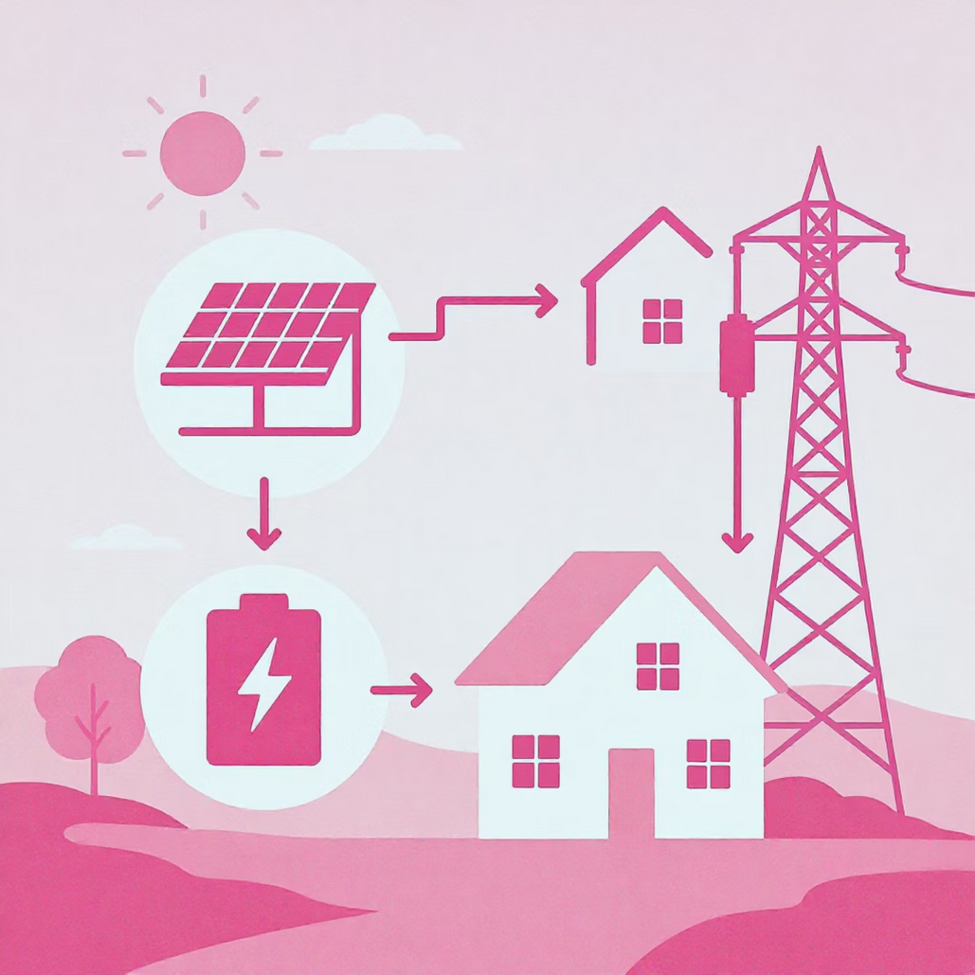
Key Decisions for Your RL Agent
The RL agent's primary goal is to make optimal decisions at each time step within the microgrid simulation. These decisions directly impact energy costs, grid independence, and renewable energy utilization.
When to store excess solar energy in batteries.
When to draw power from the battery.
When to buy electricity from the main grid.
When to sell excess electricity back to the main grid.
Notes:
6

Slide 7
Objective Functions: Driving Optimal Behavior
The agent’s learning is shaped by a reward function that balances financial and environmental goals. This multi-objective optimization is crucial for sustainable microgrid operations.
Minimize Operating Costs
Maximize Clean Energy Use
Ensure Reliability
Maintain stable power supply for consumers, avoiding outages and demand-supply imbalances.
Reduce energy bills from the grid, minimize battery degradation costs, and optimize renewable self-consumption.
Prioritize solar/wind power, reduce reliance on fossil fuel-based grid electricity.
Notes:
7

Slide 8




Expected Outcomes of Your Simulation
Significant Cost Savings
Demonstrable reduction in microgrid operating expenses.
Enhanced Renewable Integration
Higher utilization of onsite clean energy generation.
Improved Grid Stability
Reduced strain on the main grid through intelligent energy arbitrage.
Robust Decision-Making
A proven, adaptive control strategy for dynamic energy environments.
Notes:
8

Slide 9
Next Steps & Further Exploration
Experiment with RL Algorithms: Compare the performance of different algorithms (e.g., Q-learning vs. DDPG) in your microgrid.
Integrate Predictive Models: Use short-term forecasts for solar generation and demand to inform the agent's decisions.
Scalability & Generalization: Test your agent on different microgrid configurations and varying environmental conditions.
Multi-Agent Systems: Explore collaborative or competitive agents in a larger energy network.
Real-World Data Integration: Transition from synthetic to real microgrid data for higher fidelity simulations.
Thank you!
Notes:
10

